Slide 1
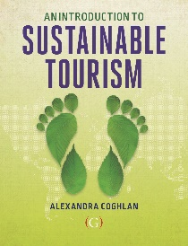
Tools for sustainable tourism
Lecture 7
© Alexandra Coghlan 2019 Introduction to Sustainable Tourism

Slide 2
A TOOLBOX for sustainable tourism
A way to identify what is important to stakeholders
- remember governance & partnerships
Establish markers of what should be preserved and protected to ensure sustainability – what we CARE ABOUT
Setting upper and lower ranges for those markers,
Measuring and communicating those markers
Identifying (predictive) relationships between those markers
© Alexandra Coghlan 2019 Introduction to Sustainable Tourism

Slide 3
Four different types of tools
Measure the levels of impact
Command and control tools
Economic incentives
Voluntary practices
Supporting mechanisms
© Alexandra Coghlan 2019 Introduction to Sustainable Tourism

Slide 4
1. Measure levels of impact
The ‘original’ situation is often unknown
Relative situations: research occurs after changes occur
Information is limited
Incremental effects
© Alexandra Coghlan 2019 Introduction to Sustainable Tourism

Slide 5
A range of impact measurement tools
Visitor Impact Management (VIM)
Visitor Experience and Resource Protection (VERP)
Visitor Activity Management Process (VAMP)
Recreation Opportunity Spectrum (ROS)
Tourism Optimisation Management Model (TOMM)
As well Environmental Impact Assessment tools
© Alexandra Coghlan 2019 Introduction to Sustainable Tourism

Slide 6
Difficulty in assessing impacts
Most sites are unique
Impacts may result from many activities, not just tourism
Time lag between cause & effect
Little consensus on which indicators are most appropriate to indicate change

Slide 7
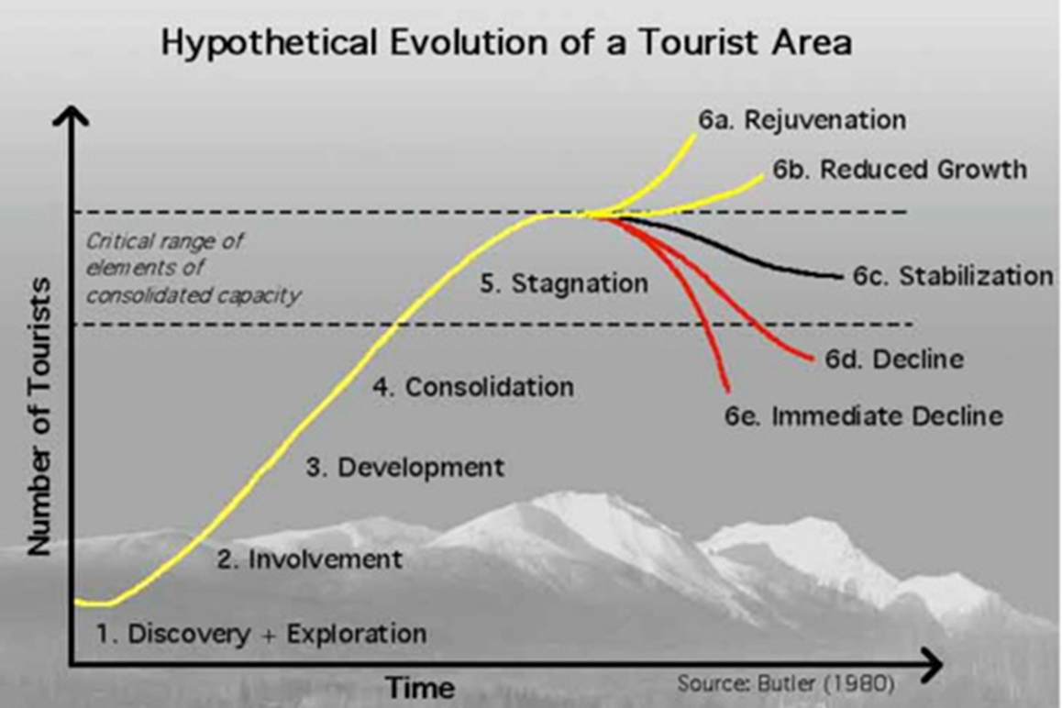
INDICATORS
Indicators are variables providing information about the status of some phenomenon
What is the question that we want to answer using an indicator, and will the indicator answer that question?
Does the selected indicator demonstrate a direct relationship with the natural, social, or economic status of tourism?
Can the indicator be measured easily and relatively inexpensively, i.e. will it be worth collecting?
Will the indicator trigger action before the conditions have deteriorated to an unacceptable level?
© Alexandra Coghlan 2019 Introduction to Sustainable Tourism

Slide 8
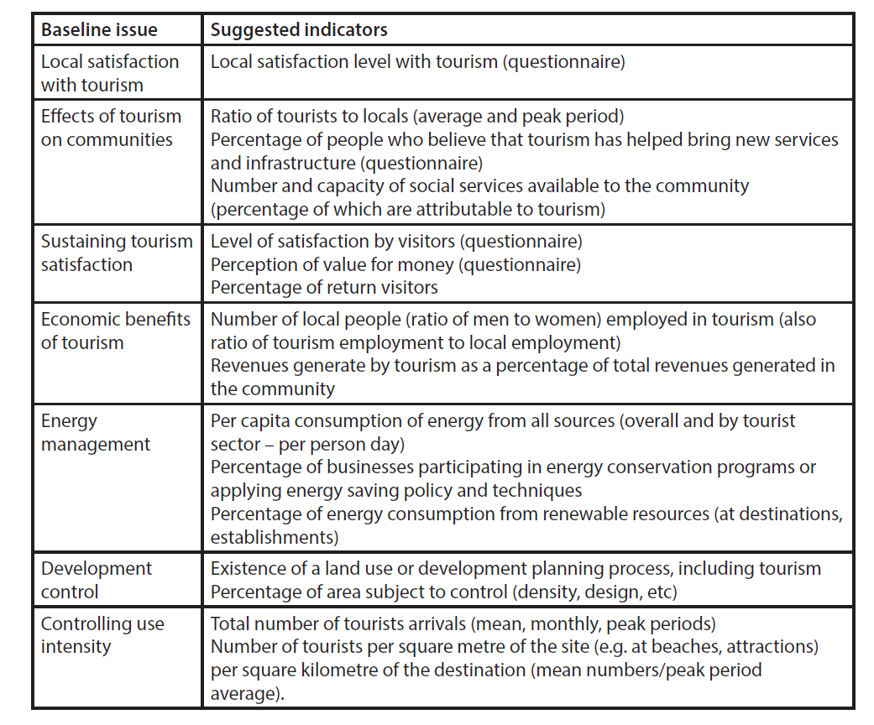
© Alexandra Coghlan 2019 Introduction to Sustainable Tourism

Slide 9
Challenges of indicators
fuzzy boundaries of complex tourism systems
incompatible timeframes of monitoring vs. political process
nonlinear relationships between cause & effect
lack of knowledge regarding benchmarks & thresholds
potential incompatibility between environmental, economic & sociocultural outcomes
© Alexandra Coghlan 2019 Introduction to Sustainable Tourism

Slide 10
Limits of acceptable change
Moves away from linear thinking.
Recognises a complex system, and that change is INEVITABLE
so instead… 9 step systematic process
© Alexandra Coghlan 2019 Introduction to Sustainable Tourism

Slide 11
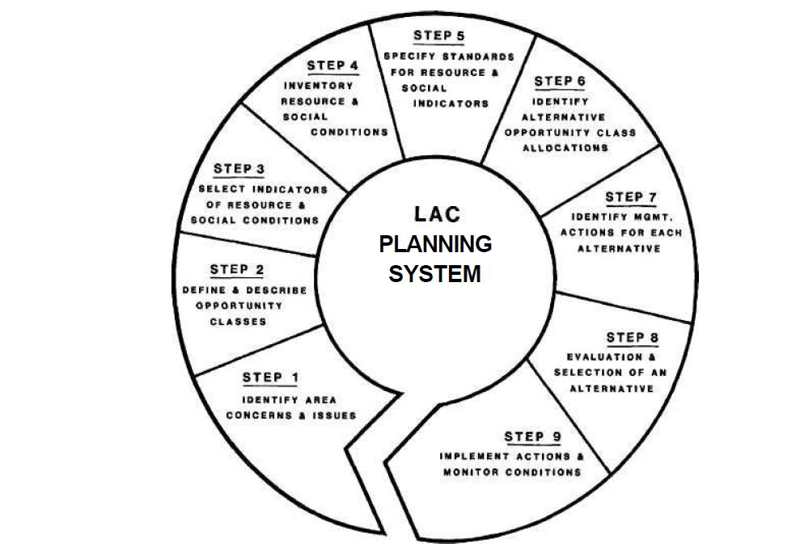
9 steps of LAC process
1. Identity areas’ special values, issues & concerns
2. Identify & describe recreation opportunity classes
3. Select indicators of resource and social conditions
4. Inventory existing resource and social conditions
5. Specify standards for resources and social conditions in each opportunity class
6. Identify alternative opportunity class allocations
7. Identify management actions for each alternative
8. Evaluate and select preferred alternative
9. Implement actions and monitor conditions.
© Alexandra Coghlan 2019 Introduction to Sustainable Tourism

Slide 12
2. Command and control
The policies and regulations that manage tourism, e.g. building codes, health and safety regulations, labour laws, council planning, zonation, visa, entry permit, taxes
COVERED IN LECTURE 4
© Alexandra Coghlan 2019 Introduction to Sustainable Tourism

Slide 13
3. Economic incentives
Taxes
Entry permits
Subsidies and grants
Prizes and awards
Marketing and demarketing activities
© Alexandra Coghlan 2019 Introduction to Sustainable Tourism

Slide 14
Demarketing: selective vs general
© Alexandra Coghlan 2019 Introduction to Sustainable Tourism

Slide 15
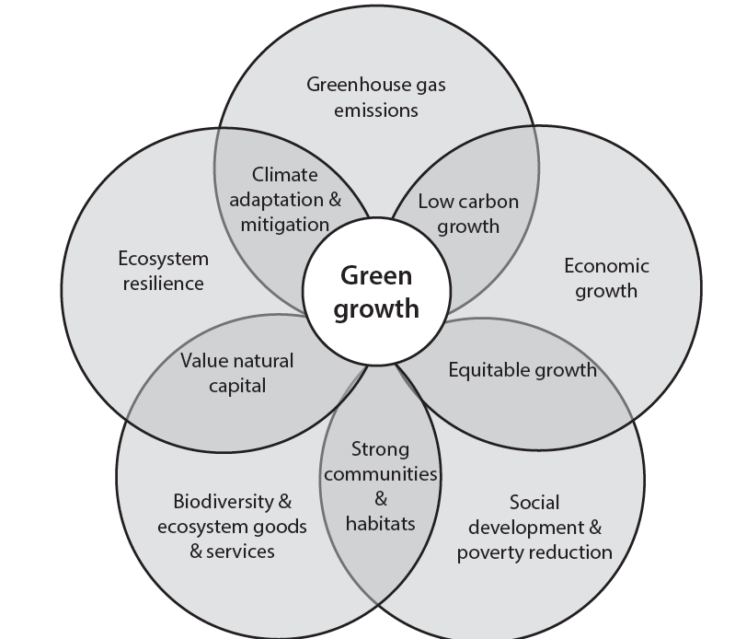
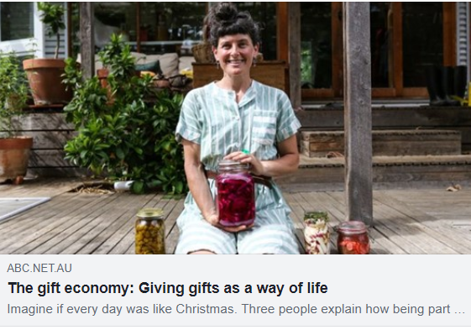
Alternative economic models
Circular economy
Green economy
Shared economy
Gift economy
© Alexandra Coghlan 2019 Introduction to Sustainable Tourism

Slide 16
4. Voluntary mechanisms
Codes of practice
Forms of certification, e.g. ecolabels or B-corp certification
© Alexandra Coghlan 2019 Introduction to Sustainable Tourism

Slide 17
© Alexandra Coghlan 2019 Introduction to Sustainable Tourism

Slide 18
PATAGONIA – B Corp.
© Alexandra Coghlan 2019 Introduction to Sustainable Tourism

Slide 19
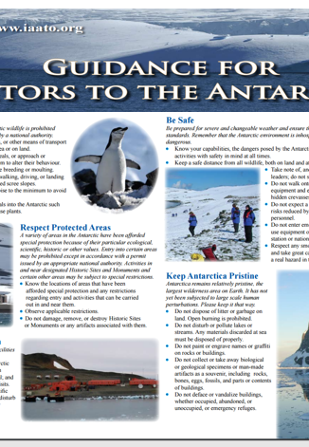
Codes of practice
Negatives:
- voluntaryno timelines
voluntary
vague, general
self-regulated
Positives:

Slide 20
Whale watching code for boats

Slide 21
Ecolabels operate on the supply side of sustainable tourism and are understood to establish business compliance with external standards of positive environmental performance
Widely available over the last 30 years, 47 different schemes exist but only adopted by 1% of tourism businesses.
They are seen to serve three general purposes:
1. Standardise desirable environmental performance levels across the sector,
2. Ensure certified businesses understand and meet those performance levels
3. Serve as competitive point of difference for a market looking for green products.
© Alexandra Coghlan 2019 Introduction to Sustainable Tourism

Slide 22
Ecolabels: pros and cons
Low implementation costs, when compared to government regulations.
Cost savings from operating more efficiently.
Marketing advantages for the environmentally-conscious tourism market
Credibility through the third party auditing system.
The cost of implementation, as businesses sign up to the certification program and must complete the paperwork associated with the environmental performance (and change their practices in some cases).
The low level of consumer awareness of labels, reducing any marketing advantage.
The variability in quality and issue of credibility between programs
The lack of a measure of the effectiveness of ecolabels
The issue of inequality in developing countries.
© Alexandra Coghlan 2019 Introduction to Sustainable Tourism

Slide 23
Other tools?
Interpretation
Carbon calculators
Training programs
Industry toolkits
© Alexandra Coghlan 2019 Introduction to Sustainable Tourism

